Slide 1


Capstone Project:
Exploring Coffee Quality Data with Power BI
By Glanet Castelino
ID_S12125

Slide 2

Data Overview
📊 Data:
Covers production, processing & sensory evaluation
Sensory Evaluation Metrics (10 features): Aroma , Flavor, Aftertaste , Acidity , Body , Balance , Uniformity , Clean Cup , Sweetness , Total Cup Points
⚠️ Defects: Category 1 and Category 2
Category One (visual): black beans, sour beans, insect/fungus damage
Category Two (taste-based): over-fermentation, staleness, rancidness, chemical taste
☕ Coffee Quality Institute (CQI)
Non-profit, founded 1996, California (USA)
Mission: Improve global coffee quality & value. Works with growers, processors, roasters, and stakeholders
Focus: Research, Training, Certification, Sustainability

Slide 3
Data pre-processing:
Lot Number → Nulls replaced, translated to English
Altitude → Split ranges, calculated averages
Region → Blanks filled (Not Available), translated, proper case
Bag Weight → Removed “kg”, trimmed spaces
Harvest Year → Extracted start year, trimmed
Grading Date → Standardized to date format – Grading Norm_Date
Variety / Status → Unified blanks & unknowns → Not Available; proper case
Processing Method → Standardized categories (Washed, Natural, Honey, Not Available) , Proper case
Color → Standardized color names
Expiration → Standardized to yyyy-mm-dd
General → Deleted blank rows
No Changes Needed: Aroma, Flavor, Aftertaste, Acidity, Body, Balance, Uniformity, Clean Cup, Sweetness, Overall, Defects, Total Cup Points, Moisture %, Cat 1 & 2 Defects, Quakers.

Slide 4
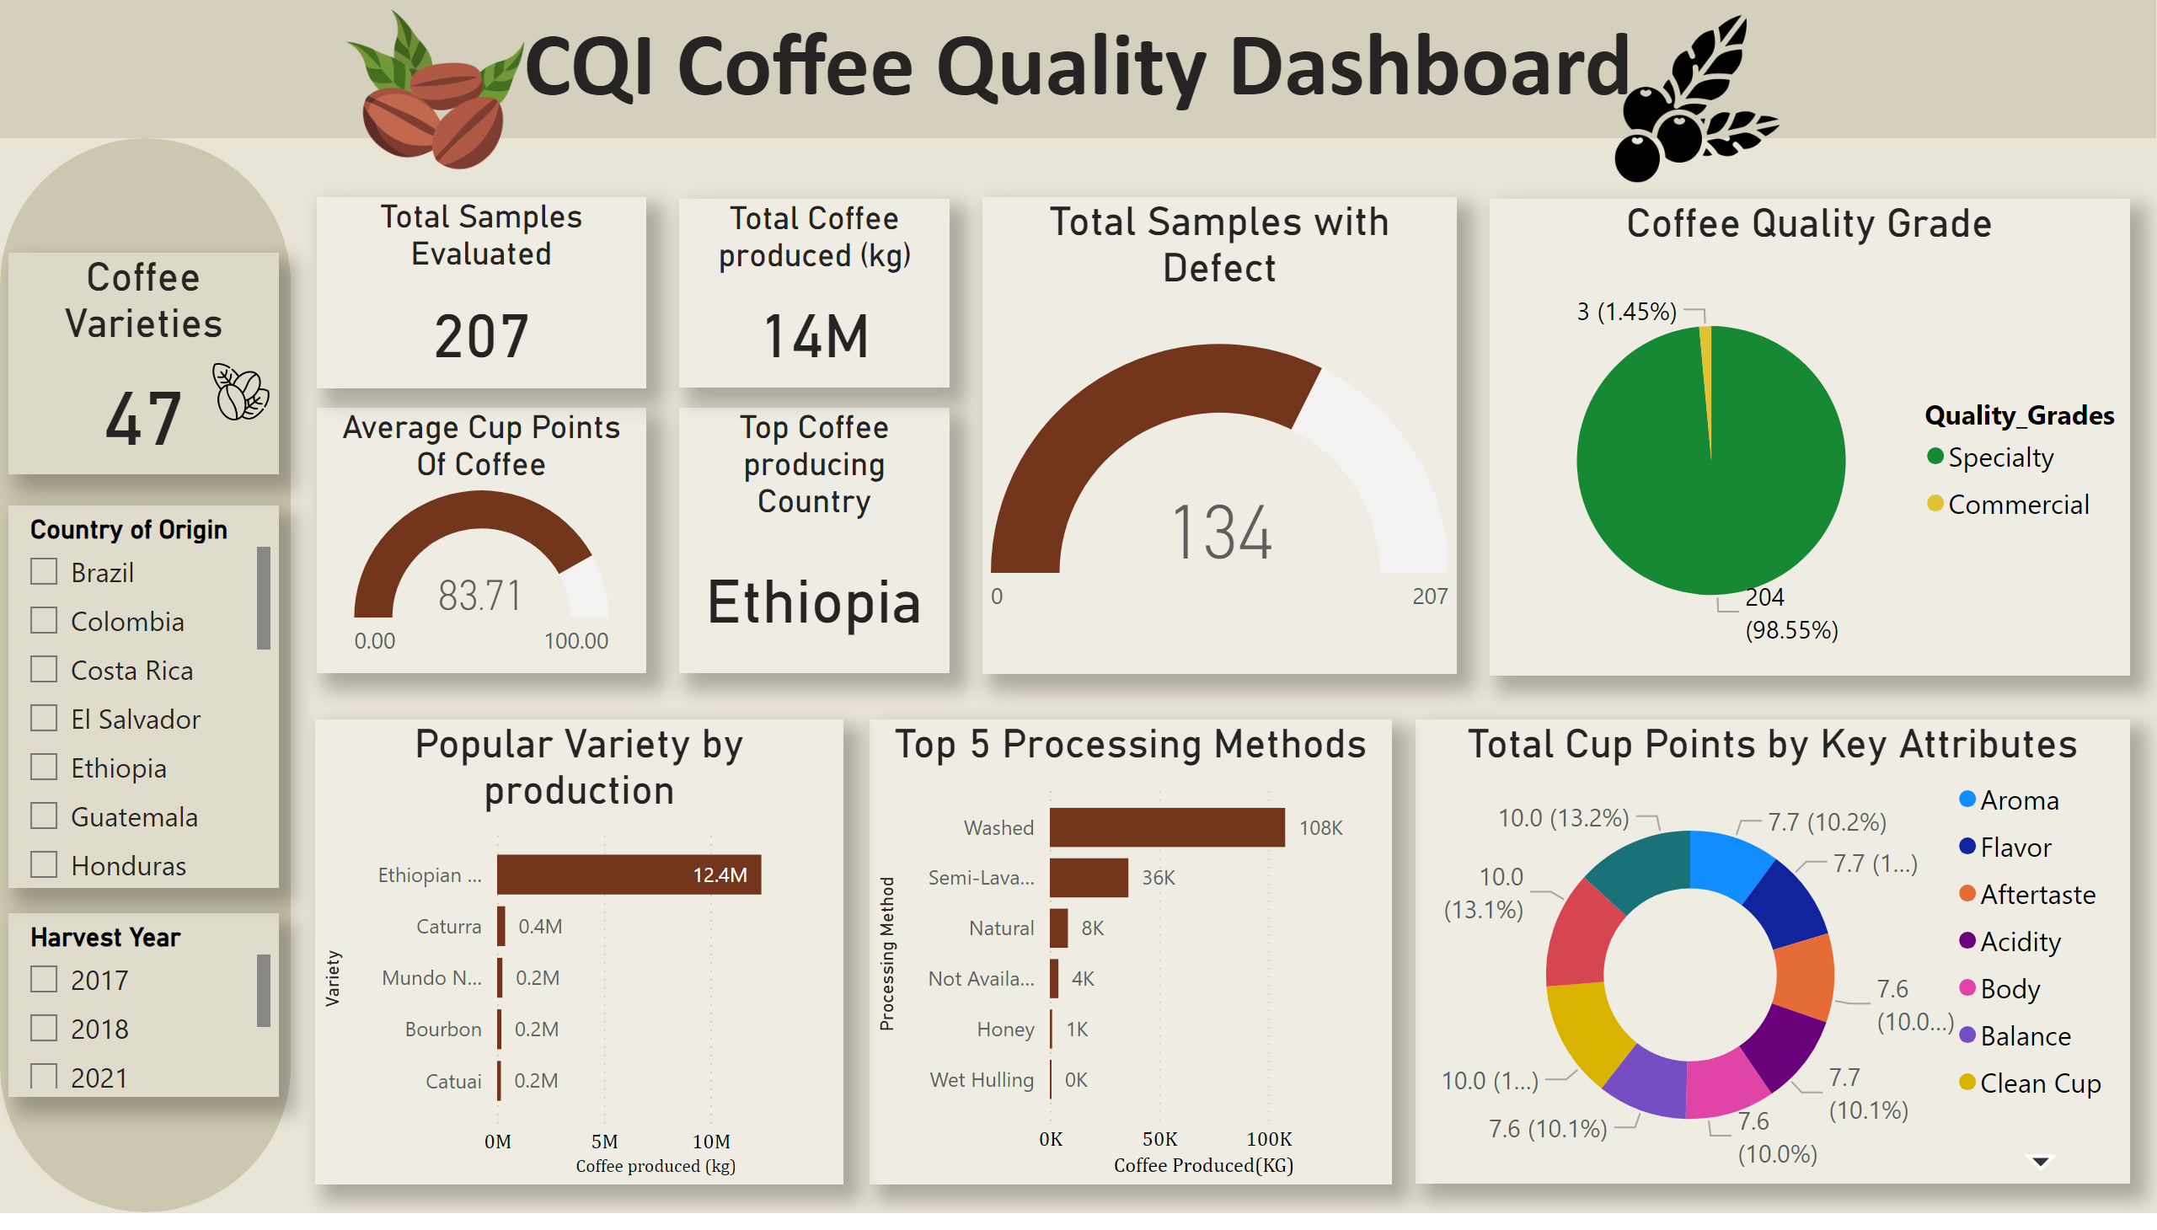
Overview
Notes:
image
No alt text provided
textbox
No alt text provided
image
No alt text provided
shape
No alt text provided
slicer
No alt text provided
Harvest Year
No alt text provided
Coffee Varieties
No alt text provided
Total Samples Evaluated
No alt text provided
Coffee Quality Grade
No alt text provided
Average Cup Points Of Coffee
No alt text provided
Total Samples with Defect
No alt text provided
Top 5 Processing Methods
No alt text provided
Total Cup Points by Key Attributes
No alt text provided
Total Coffee produced (kg)
No alt text provided
Popular Variety by production
No alt text provided
Top Coffee producing Country
No alt text provided
image
No alt text provided

Slide 5
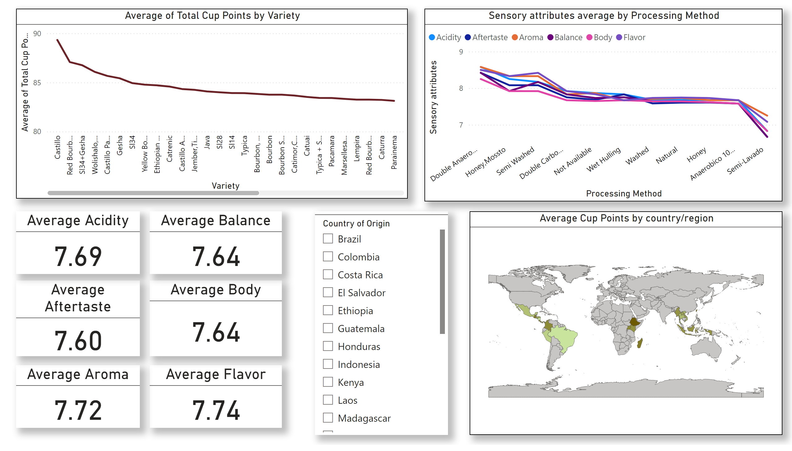
Sensory Evaluation Page
Notes:
Average Cup Points by country/region
No alt text provided
slicer
No alt text provided
lineChart
No alt text provided
Sensory attributes average by Processing Method
No alt text provided
Average Acidity
No alt text provided
Average Aftertaste
No alt text provided
Average Balance
No alt text provided
Average Body
No alt text provided
Average Flavor
No alt text provided
Average Aroma
No alt text provided

Slide 6
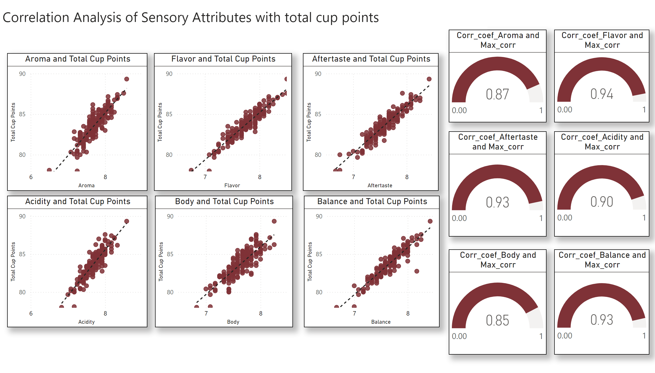
SEP_Correlation
Notes:
scatterChart
No alt text provided
scatterChart
No alt text provided
scatterChart
No alt text provided
scatterChart
No alt text provided
scatterChart
No alt text provided
scatterChart
No alt text provided
gauge
No alt text provided
textbox
No alt text provided
gauge
No alt text provided
gauge
No alt text provided
gauge
No alt text provided
gauge
No alt text provided
gauge
No alt text provided

Slide 7
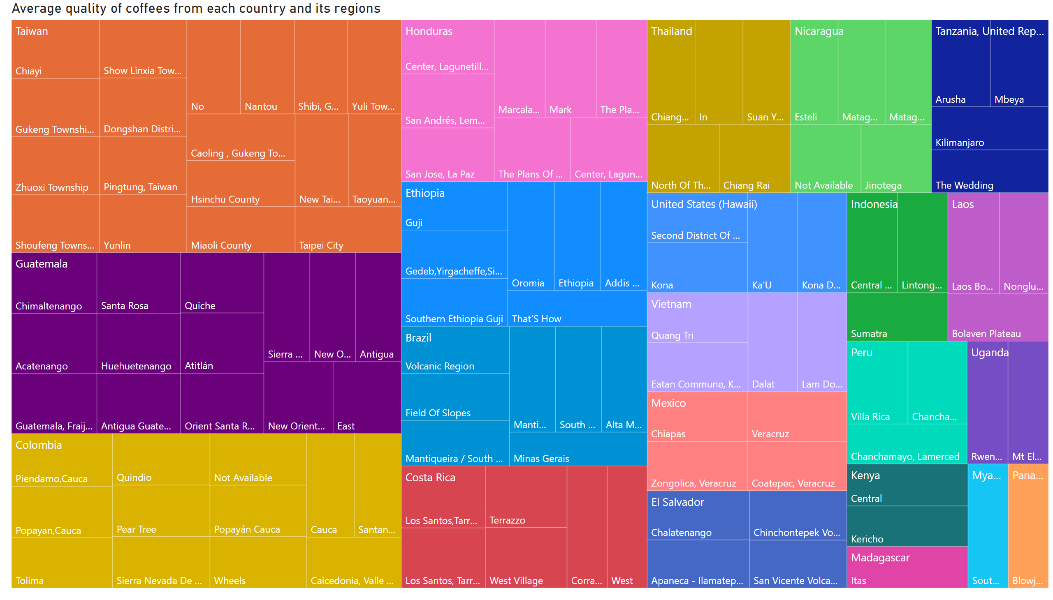
SEP Heatmap matrix
Notes:
Average quality of coffees from each country and its regions
No alt text provided

Slide 8
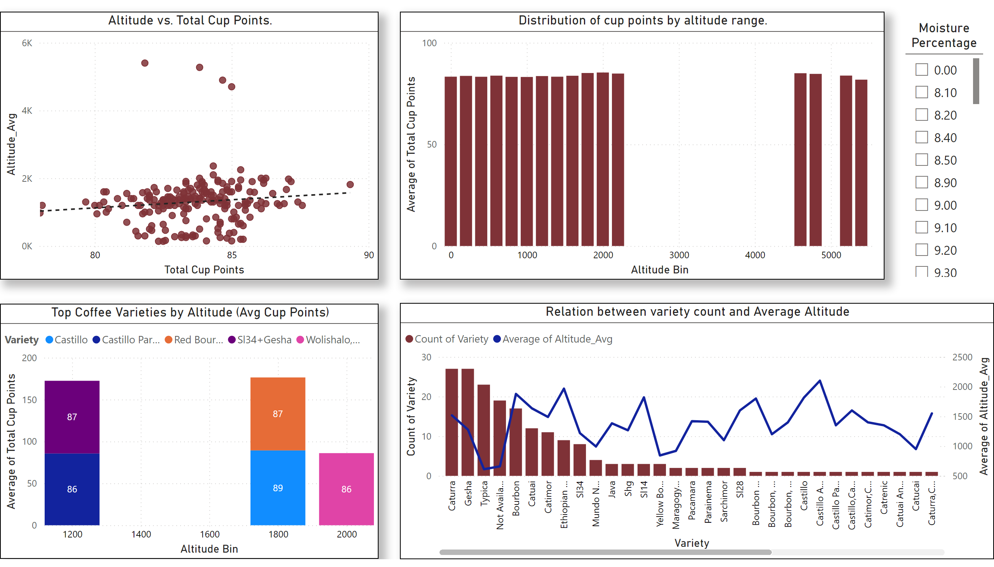
Agronomic Factors
Notes:
Altitude vs. Total Cup Points.
No alt text provided
Top Coffee Varieties by Altitude (Avg Cup Points)
No alt text provided
Relation between variety count and Average Altitude
No alt text provided
Moisture Percentage
No alt text provided
Distribution of cup points by altitude range.
No alt text provided

Slide 9
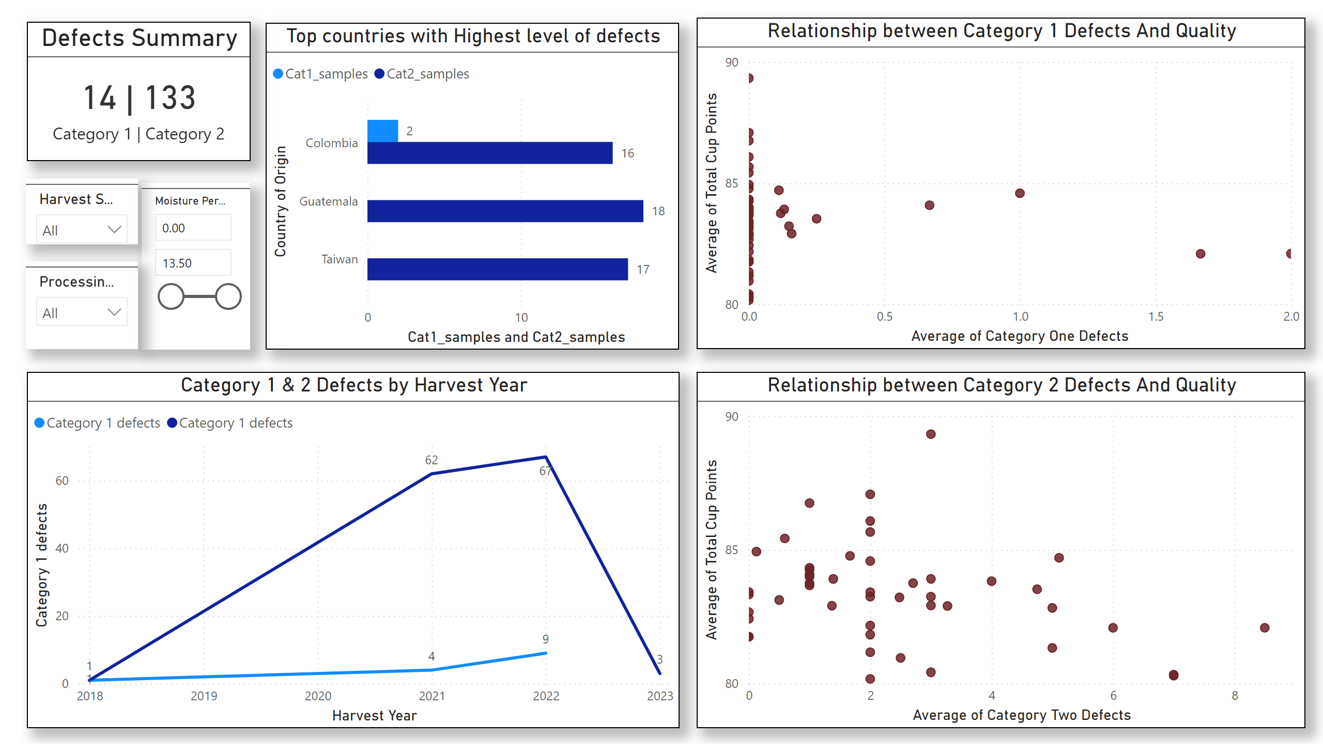
Defects Summary
Notes:
Relationship between Category 1 Defects And Quality
No alt text provided
Relationship between Category 2 Defects And Quality
No alt text provided
Category 1 & 2 Defects by Harvest Year
No alt text provided
Top countries with Highest level of defects
No alt text provided
Defects Summary
No alt text provided
slicer
No alt text provided
slicer
No alt text provided
slicer
No alt text provided

Slide 10
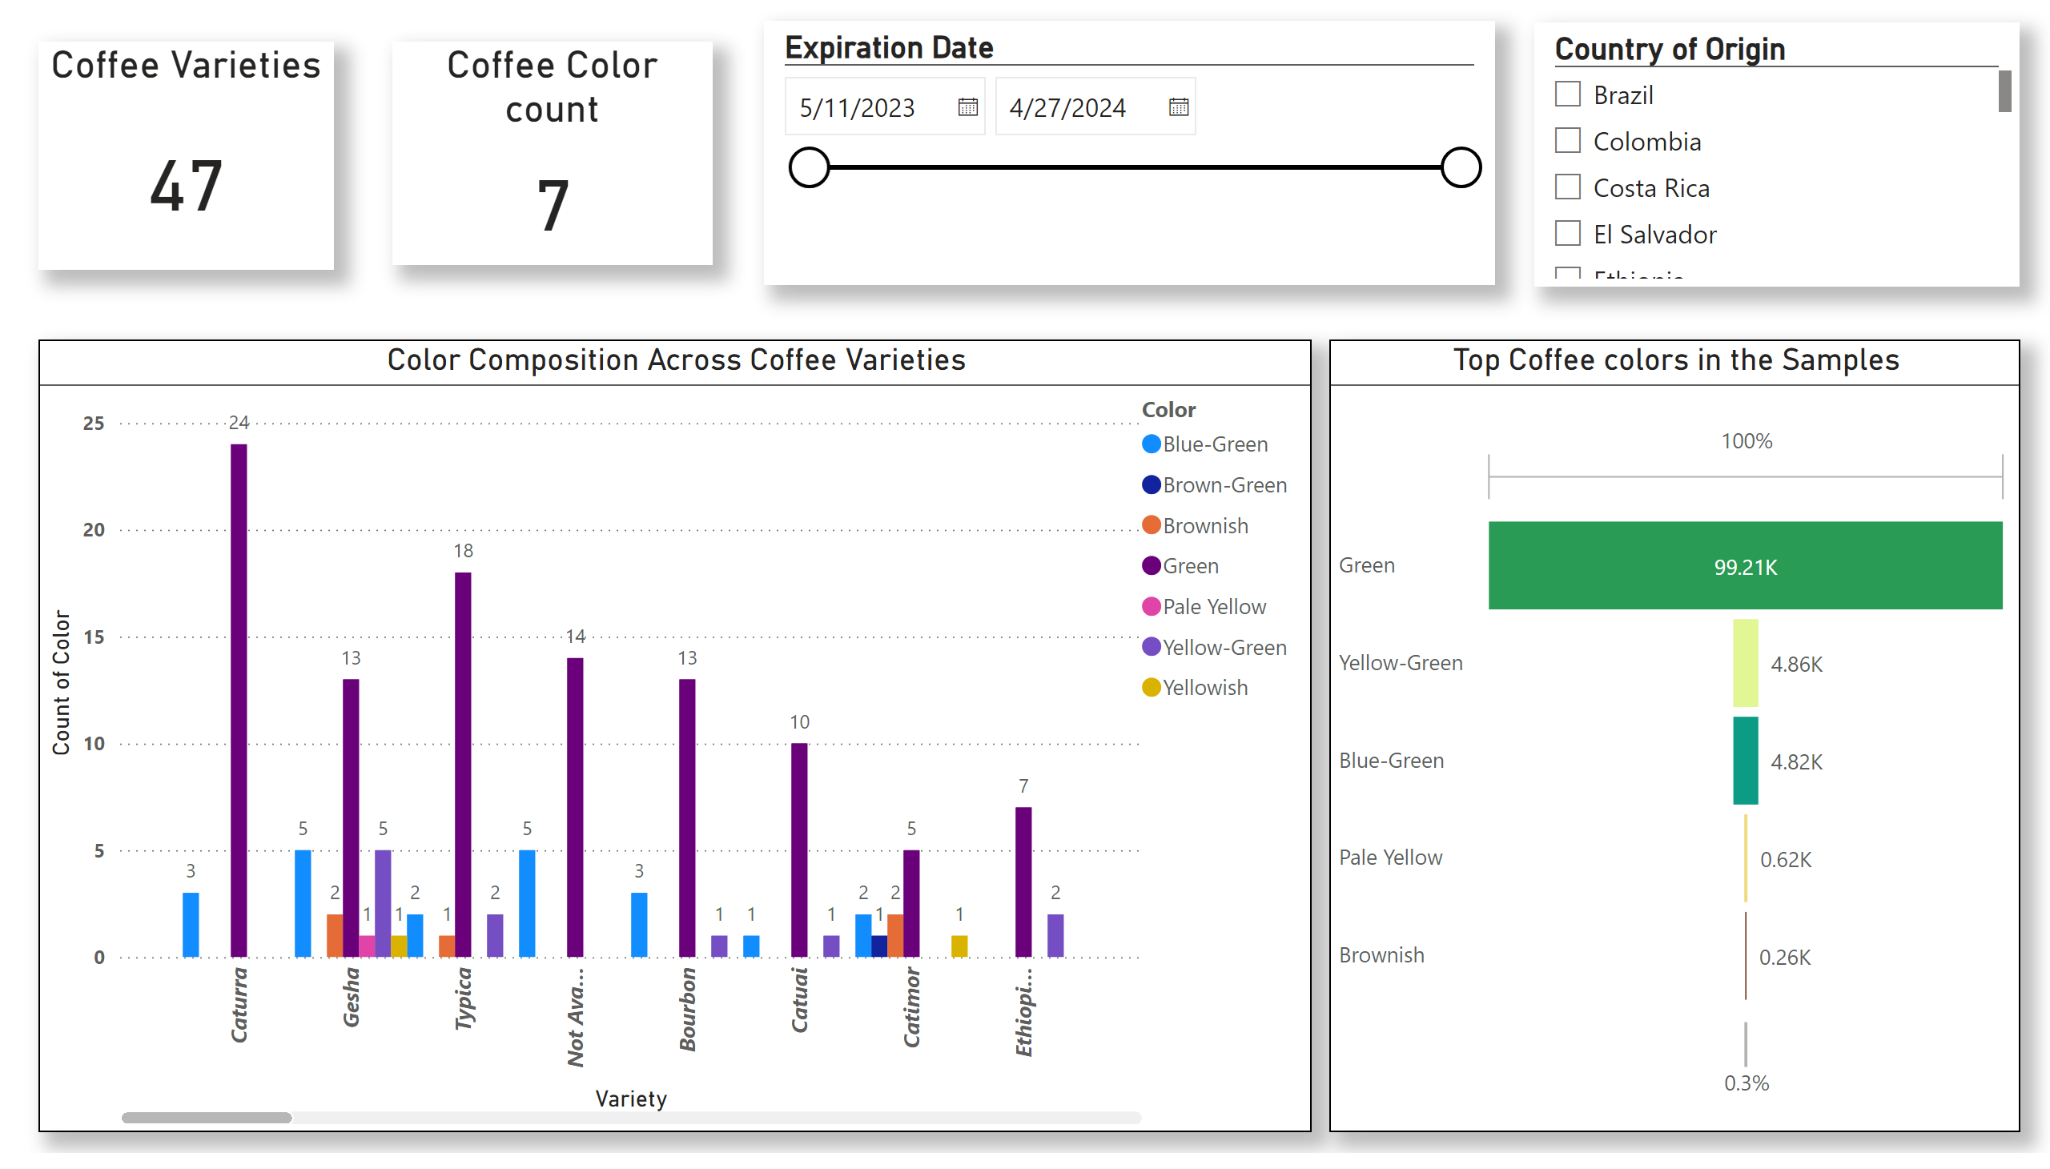
Coffee Bean Colors
Notes:
Color Composition Across Coffee Varieties
No alt text provided
Coffee Color count
No alt text provided
slicer
No alt text provided
slicer
No alt text provided
Top Coffee colors in the Samples
No alt text provided
Coffee Varieties
No alt text provided

Slide 11
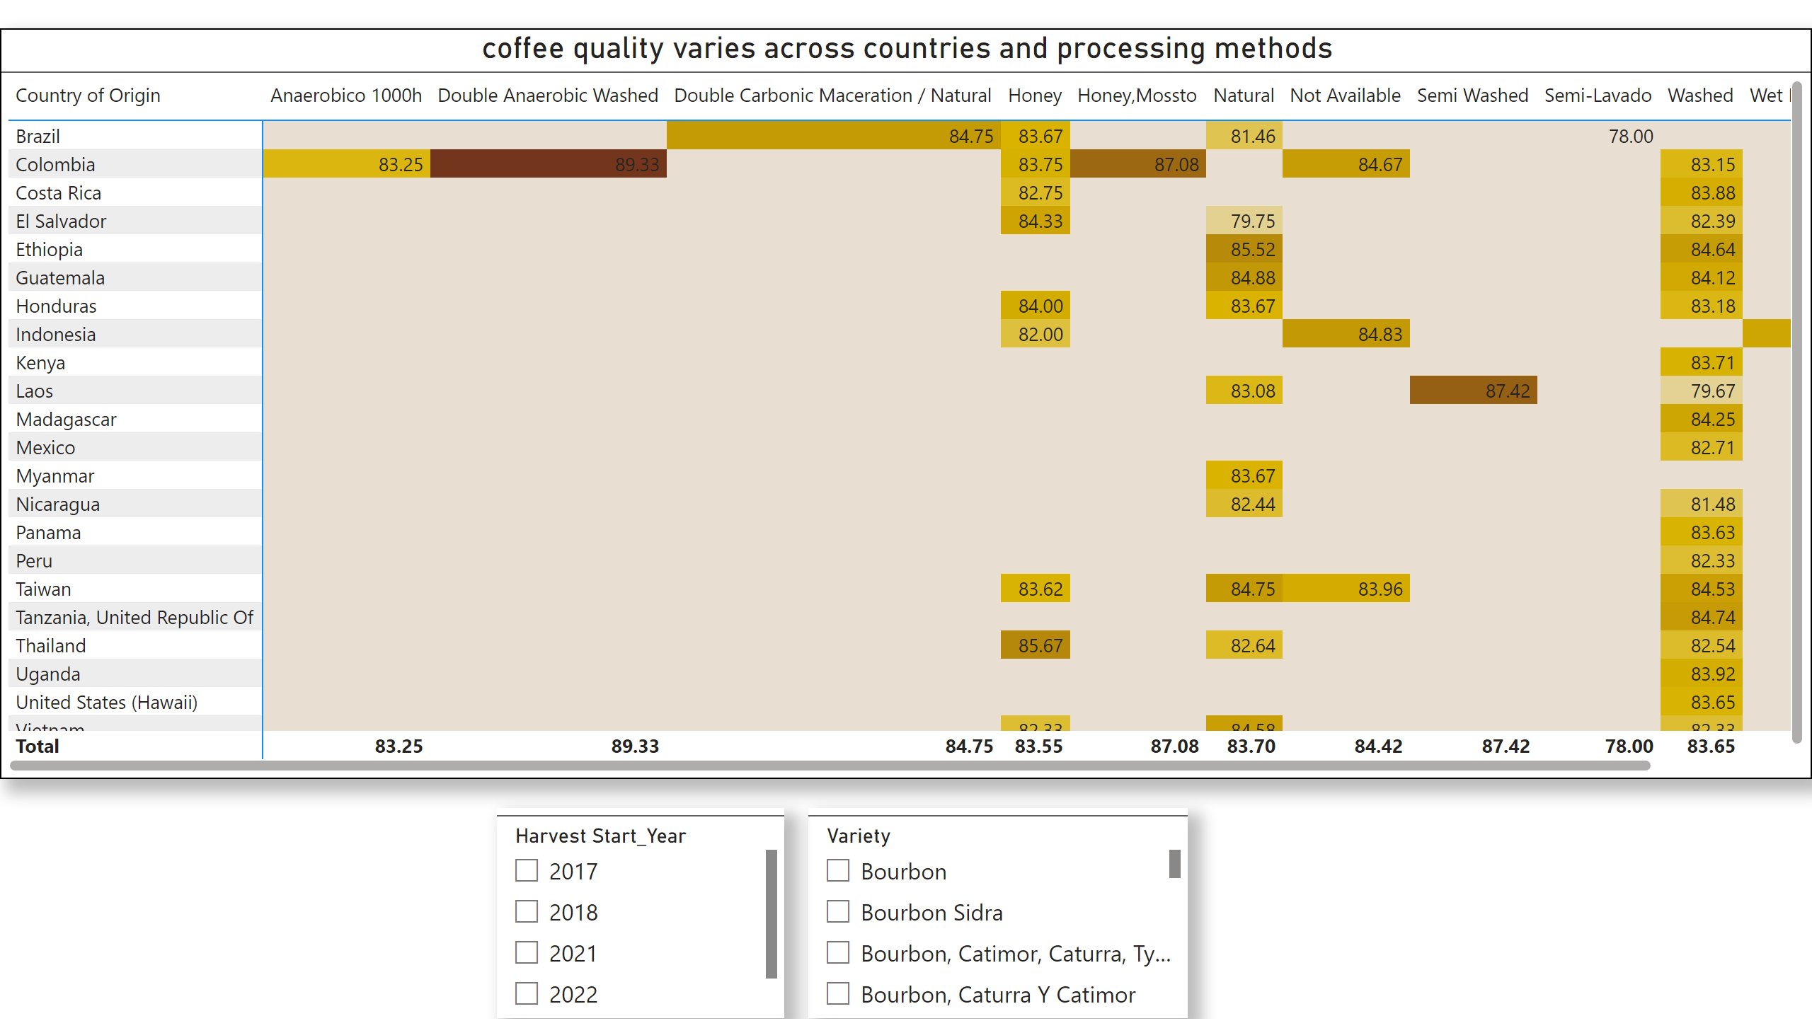
Quality analysis
Notes:
coffee quality varies across countries and processing methods
No alt text provided
slicer
No alt text provided
slicer
No alt text provided

Slide 12
Key Data Insights
1. What are the key determinants of coffee quality as evaluated through sensory attributes such as aroma, flavor, acidity, etc.?
Main sensory attributes that impact coffee quality are Flavor, Aroma and acidity
Top 3 coffee Qualities are Castillo, Red Bourbon and Sl34+Gesha (quality scores)
Attributes such as Sweetness, clean cup and Uniformity score similar throughout the dataset and do not impact the coffee quality.
2. Is there a correlation between processing methods, origin regions, and coffee quality scores?
Some processing methods consistently yield higher scores such as Double Anaerobic Washed, Semi Washed & Honey/Mossto while Methods like Semi-Lavado have slightly lower scores ( however insufficient data).
Some countries show high variability depending on processing method (e.g., Colombia vs. Brazil)

Slide 13
Key Data Insights
3. Can we identify any trends or patterns in defect occurrences and their impact on overall coffee quality?
Category 2 defects are higher than category 1
Processed methods like Honey, natural, washed correlate to more defects
Higher moisture correlates with higher defect rates
Harvest years from 2020 – 2022 have more defected beans noticed or rise
Countries like Guatemala and Columbia, Taiwan have the highest defected bean count

Slide 14
Key Data Insights
4. How do different variables interact to influence the Total Cup Points, which represent an overall measure of coffee quality?
Quality Attributes: Influenced by Acidity, flavor, Aroma, Body, Balance, and aftertaste. Attributes such as Clean cup, sweetness and uniformity have no impact.
Processing Methods with high scores: Double Anaerobic Washed, Semi Washed, and Honey/Mossto methods
Top Coffee bean variety: Castillo, Red Bourbon, and SL34+Gesha.
Top Countries with best quality scores: Ethiopia, Tanzania, Taiwan

Slide 15

Final Conclusions
Ethiopia, Taiwan, and Tanzania produce some of the highest quality coffees scores
Sensory qualities such as Aroma, Flavor, and Acidity are the primary contributors to higher cup scores.
Top 3 coffee Qualities are Castillo, Red Bourbon and Sl34+Gesha in terms of their coffee quality scores
Processing methods (Double Anaerobic Washed, Semi Washed & Honey/Mossto ) strongly influence quality outcomes.
Defects, particularly Category 2 (most frequent), have a significant impact on reducing quality scores. Moisture/ Altitude also effect the productions
Final Insight: The distinction of specialty coffee comes from the balance of where it is grown, how it is processed, defects and the sensory experience it delivers.

Slide 16

Thank you

